Slide 1
Qat the Cat –
The educational game
Issue #32

Slide 2
Group 32
Siddarth Singh
Nandi Bau
Dimpho Majatladi
Daniela Adano
Ann Vuyanzi

Slide 3
Introduction
The aim of the game:
Create a demonstration of a game as a proof of concept
Showcase the accessibility of the IBM Qiskit API
Inspire interest and awareness in quantum computing
Expose players to basic topics in quantum mechanics

Slide 4
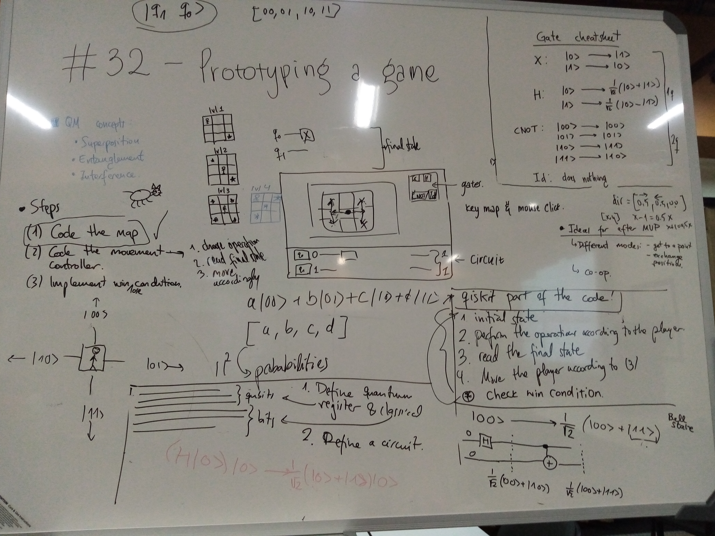
Work : The game
Puzzle maze game
We used the Pygame engine and Qiskit for the movement mechanics
Players navigate Qat the Cat to certain points on a grid map by manipulating quantum states of 2 qubits
Players control Qat by building simple circuits

Slide 5
Demo

Slide 6
Future Plans
More levels using progressive level design
More game modes
Add co-op:
• We need to ensure that players work and learn concepts together
• More fun
• Engaging
• Win or learn

Slide 7
Acknowledgements

